Slide 1
HEART DISEASE PREDICTOR
Guide by
-Dr.V.Auxilla Osvin Nancy.,M.Tech.,Ph.D.,
Done by
-MAGIZHAN SIVAKUMAR
-CSE-B
-Rajalakshmi Engineering College

Slide 2
Introduction
Heart disease prediction is essential for early diagnosis, timely intervention, and reducing death rates.
Traditional diagnostic approaches may not effectively capture the complex relationships among multiple risk factors.
Machine learning techniques offer a data-driven approach by analyzing historical medical data to uncover hidden patterns.
This project uses Random Forest and other classification algorithms to predict the presence of heart disease.
The goal is to improve prediction accuracy, model interpretability, and practical usability in clinical healthcare settings.

Slide 3
Literature Survey
Kumar & Paul (2016) compared ML algorithms and found SVM gave the best results (~86%).
Javeed et al. (2019) proposed an optimized Random Forest model, achieving over 90% accuracy.
Most existing models focus on accuracy but lack clinical interpretability and real-world usability.

Slide 4
Literature Survey
The Framingham Heart Study identified major risk factors for heart disease but relied on traditional statistical methods with limited accuracy for complex patterns.
Studies using the UCI Heart Disease Dataset applied machine learning models like Decision Trees, SVM, and Neural Networks, showing improved prediction performance.
Gudadhe et al. (2010) found Decision Trees to be effective, with around 81% accuracy.
Soni et al. (2011) used a hybrid clustering-classification approach, showing better accuracy than single models.

Slide 5
Objectives
To develop a machine learning-based model for accurately predicting the presence of heart disease using medical data.
To compare the performance of different classifiers such as Random Forest, Support Vector Machine, and Logistic Regression.
To identify and analyze the most significant features (risk factors) contributing to heart disease.
To improve model interpretability, making predictions more understandable for healthcare professionals.
To build a user-friendly interface or tool that can assist in early diagnosis and support clinical decision-making.
To evaluate the model using appropriate metrics such as accuracy, precision, recall, and F1-score for reliable assessment.

Slide 6

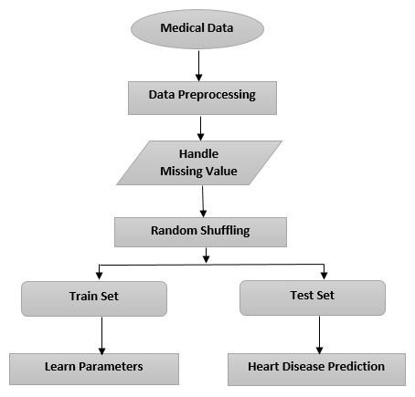
SYSTEM ARCHITECTURE

Slide 7
Methodology
Data Collection: Use the UCI Heart Disease dataset with relevant medical features.
Data Preprocessing: Handle missing values, encode categorical variables, normalize data, and split into training/testing sets.
Feature Selection: Use techniques like correlation analysis or model-based importance to select key features.
Model Training: Train models such as Random Forest, SVM, Logistic Regression, and KNN.
Model Evaluation: Evaluate using accuracy, precision, recall, F1-score, and ROC-AUC.
Interpretation: Use feature importance or SHAP values to explain model predictions.
Deployment (Optional): Create a simple interface (e.g., web app) for real-time heart disease prediction.

Slide 8
Implementation
Step 1: Environment Setup
Use Python with libraries like pandas, numpy, scikit-learn, matplotlib, and seaborn for data handling and modeling.
Step 2: Load and Explore Data
Import the UCI Heart Disease Dataset.
Analyze structure, data types, and identify missing or inconsistent values.
Step 3: Data Preprocessing
Handle missing data (if any), encode categorical variables (e.g., chest pain type), and normalize numeric features.
Split data into training and testing sets (e.g., 80% train, 20% test).
Step 4: Train Models
Implement multiple models including:
Random Forest
Support Vector Machine (SVM)
Logistic Regression
K-Nearest Neighbors (KNN)
Use GridSearchCV for hyperparameter tuning where necessary.

Slide 9
Implementation
Step 5: Model Evaluation
Evaluate using metrics: Accuracy, Precision, Recall, F1-score, Confusion Matrix, and ROC-AUC.
Compare all models to select the best-performing one.
Step 6: Interpretation and Insights
Use model-specific techniques like feature importance or SHAP values to explain predictions.
Step 7: (Optional) Build a GUI/Web App
Use Flask or Streamlit to create an interface where users can input patient data and get predictions.

Slide 10
Results
Multiple machine learning models were trained and tested on the UCI Heart Disease dataset.
Among the models tested, Random Forest achieved the highest accuracy.
Random Forest also showed strong interpretability through its feature importance scores, highlighting key predictors like:
Chest pain type
Maximum heart rate achieved
ST depression (oldpeak)
Resting blood pressure
The final model provides a reliable and interpretable prediction tool for assisting in the early detection of heart disease.

Slide 11
Model | Accuracy | Precision | Recall | F1-Score | ROC-AUC
Logistic Regression | 84% | 85% | 83% | 84% | 88%
SVM | 86% | 87% | 85% | 86% | 89%
KNN | 82% | 83% | 81% | 82% | 85%
Random Forest | 89% | 90% | 88% | 89% | 92%

Slide 12
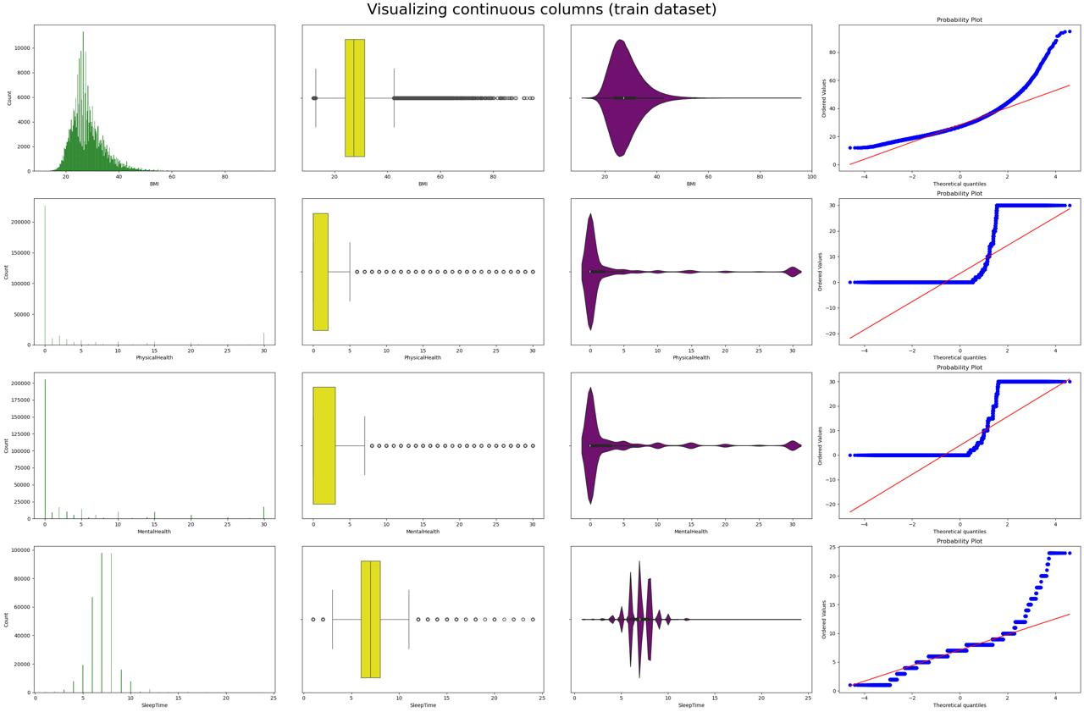

Slide 13
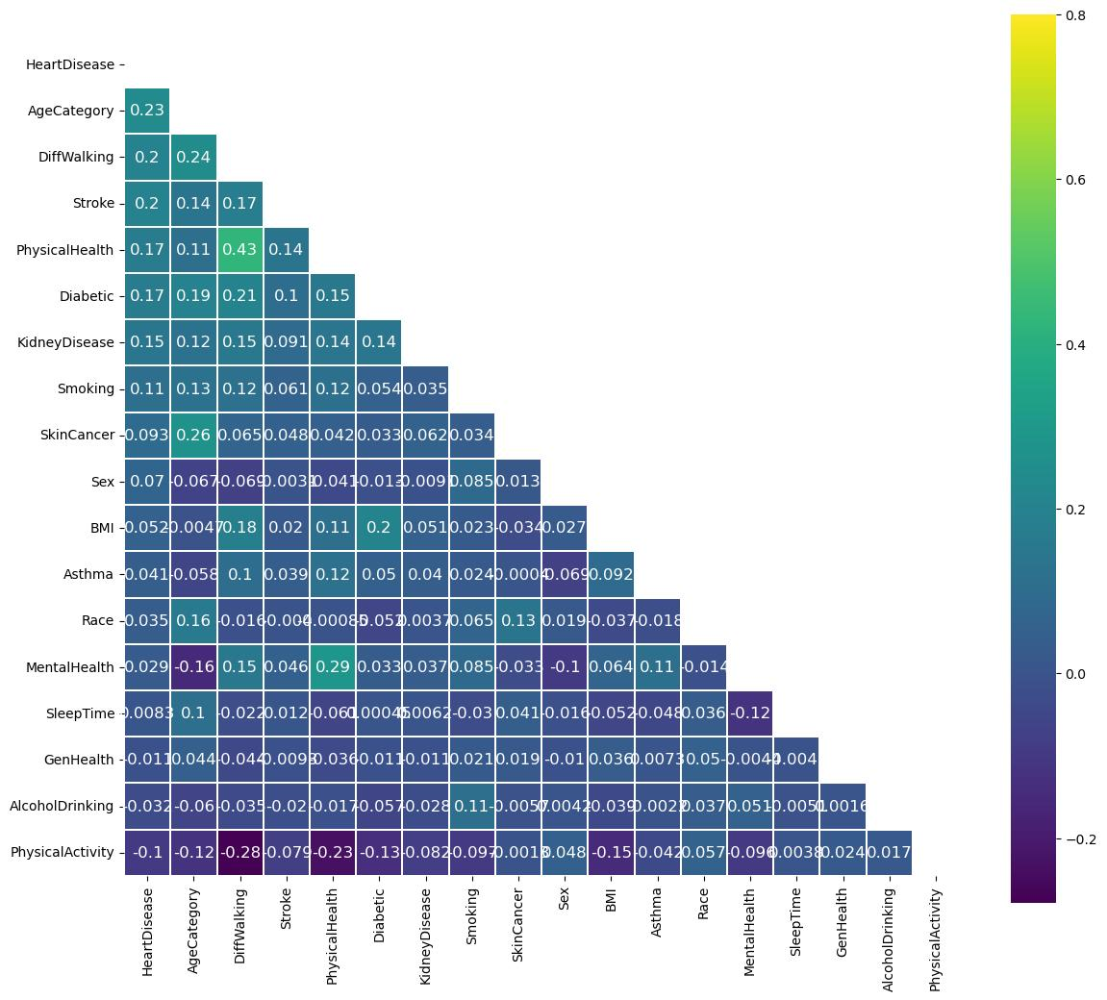

Slide 14
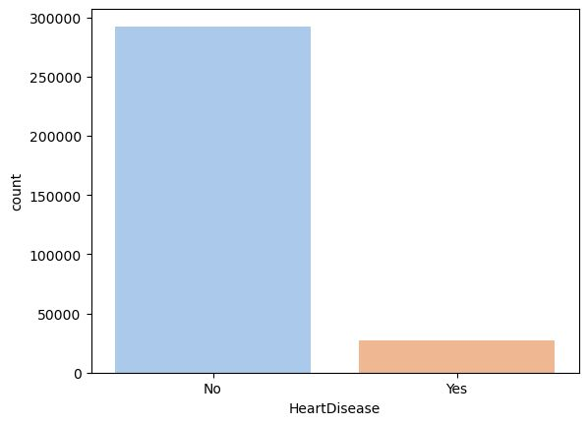

Slide 15
Comparison with existing work
Aspect | Existing Works | Your Project
Dataset Used | Mostly UCI Heart Disease dataset | UCI Heart Disease dataset
Algorithms Used | Decision Tree, Naïve Bayes, SVM, Logistic Regression | Random Forest, SVM, Logistic Regression, KNN
Accuracy Achieved | 78% – 86% | Up to 89% (Random Forest)
Interpretability | Limited or not included | Included using feature importance and SHAP values
Evaluation Metrics | Mostly Accuracy | Accuracy, Precision, Recall, F1-Score, ROC-AUC

Slide 16
Conclusion
The project successfully developed a machine learning-based model for predicting heart disease using the UCI Heart Disease Dataset.
Among various classifiers tested, Random Forest performed the best with an accuracy of 89%.
The model's interpretability was enhanced using SHAP values and feature importance, allowing healthcare professionals to better understand the driving factors behind predictions.
The project demonstrated that machine learning can be a valuable tool for early heart disease detection, with the potential to assist in clinical decision-making and improve patient outcomes.

Slide 17
Future Work
Model Enhancement: Explore more advanced models like Deep Learning (e.g., Neural Networks) to further improve accuracy and robustness.
Real-Time Deployment: Integrate the model into a real-time prediction system or mobile application for widespread use in hospitals and clinics.
Data Expansion: Incorporate additional datasets and more features (e.g., genetic data, lifestyle factors) to improve prediction accuracy and provide a more holistic view of heart disease risks.
Automated Monitoring: Develop systems for continuous monitoring and prediction using real-time health data (e.g., from wearable devices) to detect potential heart disease indicators earlier.

Slide 18
REFERENCE
1.World Health Organization . World Health Statistics 2021. World Health Organization; Geneva, Switzerland: 2021. [Google Scholar]
2.Iswisi A.F.A., Karan O., Rahebi J. Diagnosis of Multiple Sclerosis Disease in Brain Magnetic Resonance Imaging Based on the Harris Hawks Optimization Algorithm. BioMed Res. Int. 2021;2021:3248834. doi: 10.1155/2021/3248834. [DOI] [PMC free article] [PubMed] [Google Scholar] [Retracted]
3.Al-Safi H., Munilla J., Rahebi J. Harris Hawks Optimization (HHO) Algorithm based on Artificial Neural Network for Heart Disease Diagnosis; Proceedings of the 2021 IEEE International Conference on Mobile Networks and Wireless Communications (ICMNWC); Tumkur, India. 3–4 December 2021; pp. 1–5. [Google Scholar]

Slide 19
THANK YOU

